Slide 1


DACM
CASE

Slide 2
CONTENTS
01
Identifying issues
04
Solution architecture
Looking at the specification and source material.
Layers, DTOs, Interfaces, etc.
02
Making decisions
05
Deployment architecture
What do we do with what is not specified? Scoping the case.
How an AWS deployment could look like.
03
What is missing?
06
Summary
What has intentionally been left out.
What could have been different.

Slide 3
IDENTIFYING ISSUES
Models:
Keys - How do they work?
Inconsistent casing
Magical values like “ToBeDefined”
Integer properties that are sometimes strings
Etc.
Data:
Replicated data between models
Missing link between models

Slide 4
MAKING DECISIONS
Technical:
REST
AWS
Docker
.Net 8 - Use minimal API project template
Scoping:
Implement GET, POST, PUT, DELETE endpoints for Asset
Implement GET endpoint for Order to prove missing link is implemented
Implement Unit Test for one entity
Implement Integration Test for one endpoint

Slide 5
WHAT IS MISSING?
Security, Credentials and Permissions
Data Validation
Versioning
Caching
Circuit Breaker
Real source of Data (DB, API, …)
Pre-signed URLs for downloadables
Etc.

Slide 6
SOLUTION ARCHITECTURE
Separation and layers
DTOs
Test projects
Maintainability
Performance

Slide 7
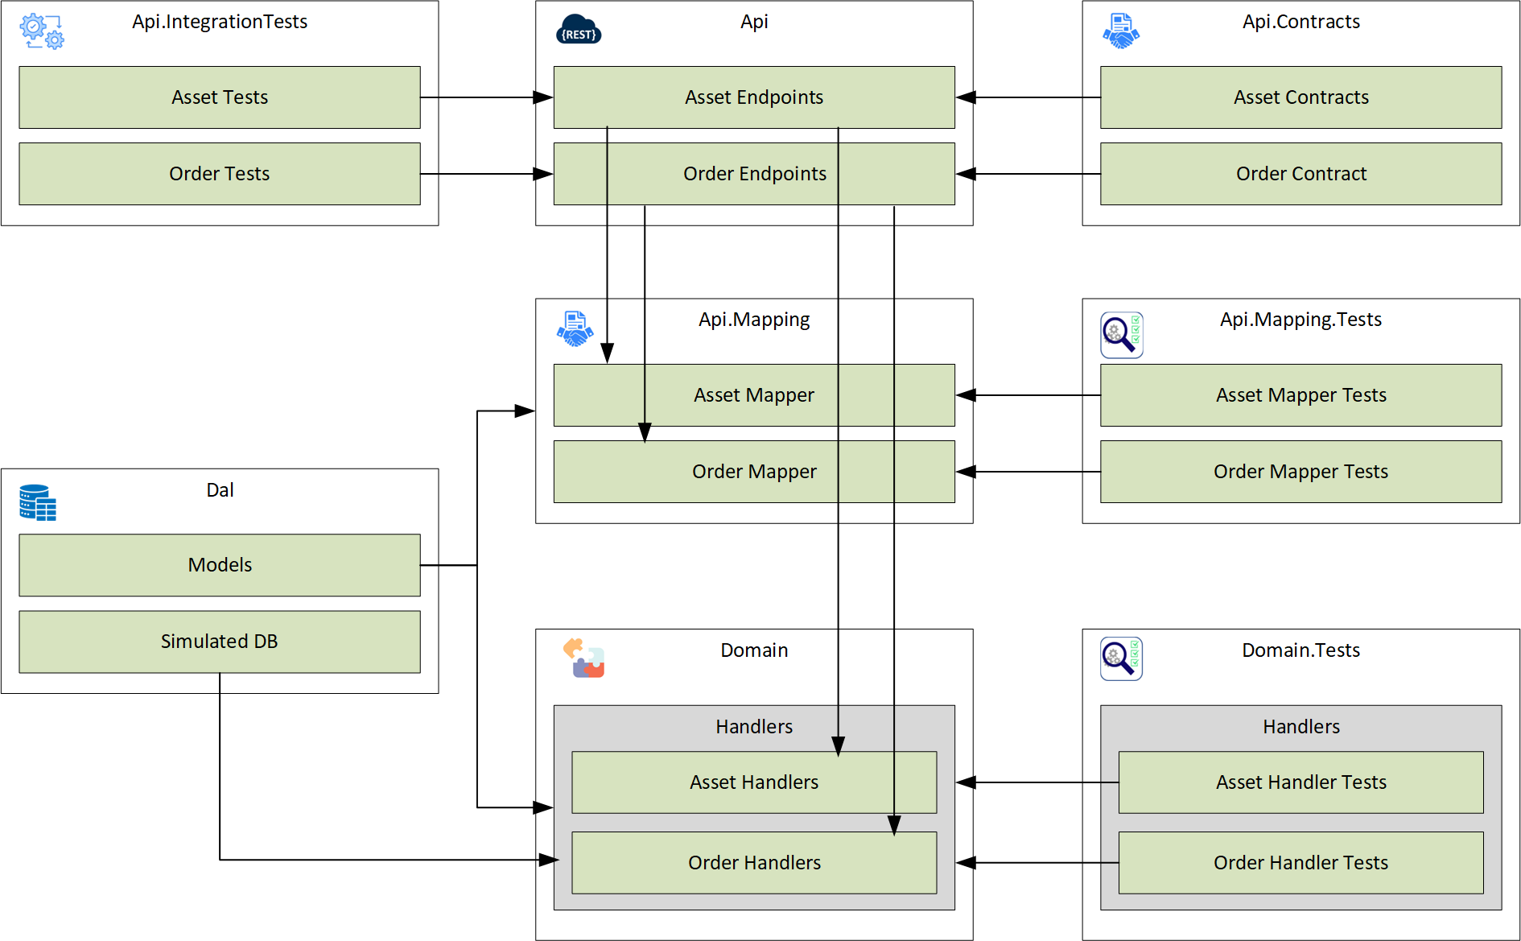

Slide 8
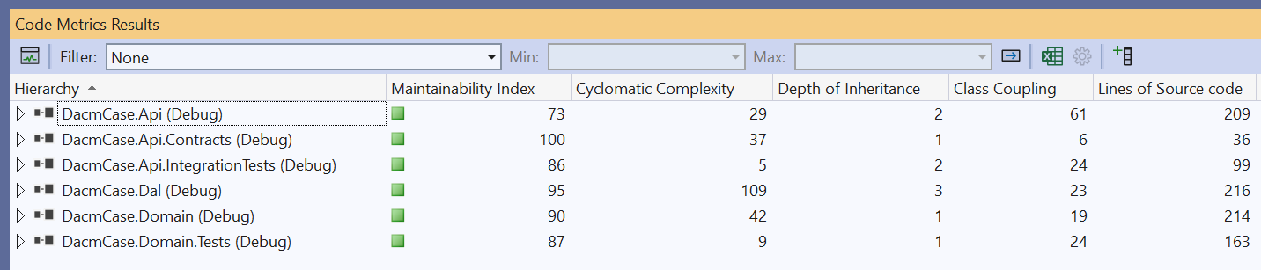
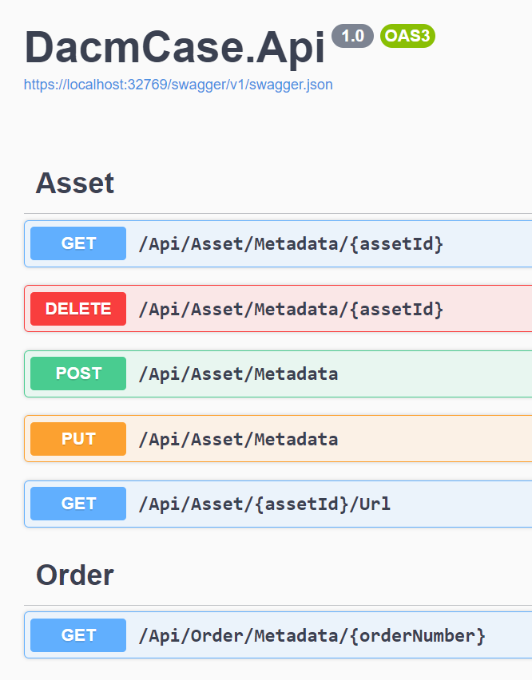
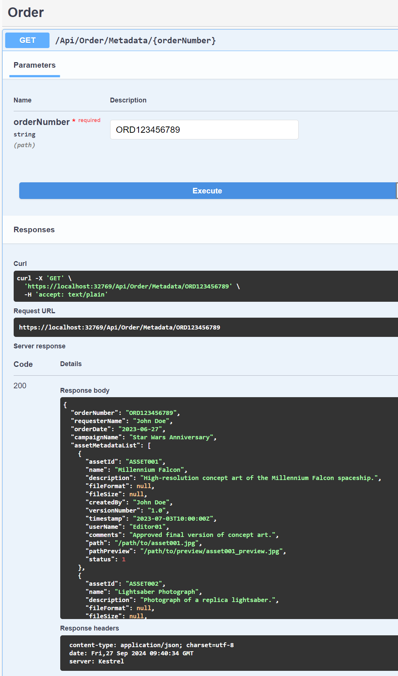
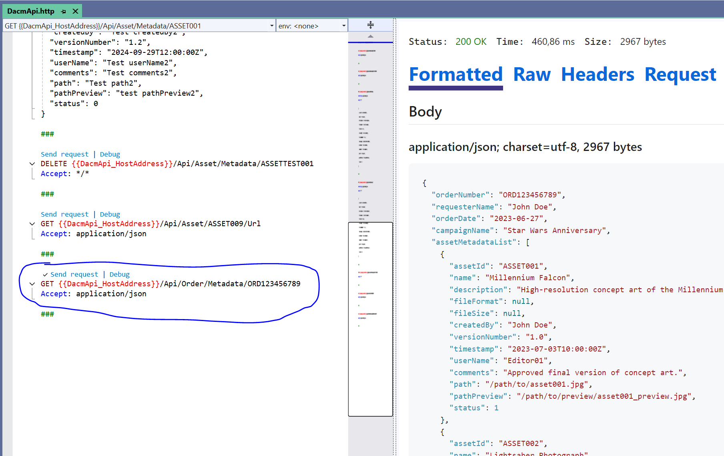
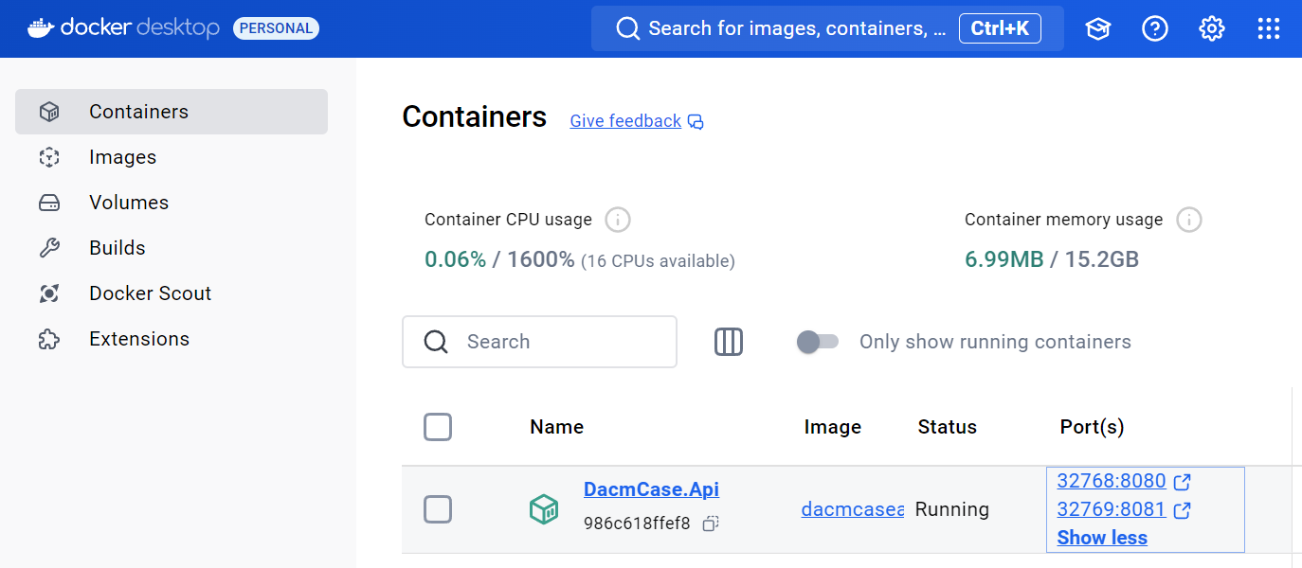

Slide 9
DEPLOYMENT ARCHITECTURE
Simplest for this showcase
Lambda vs. EC2 vs. Elastic Container vs. BeanStalk vs. ELB vs. ….
CDN and Storage
SQS
Data sources
Scalability - No bottlenecks
Performance

Slide 10
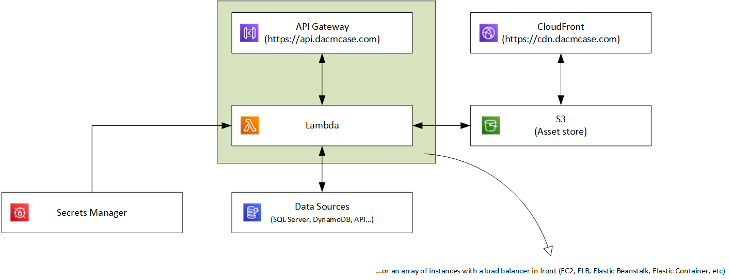
Simplest deployment on AWS

Slide 11
SUMMARY
A lot of assumptions and decisions have been made.

